Slide 1
Selection
Notes:
Purpose:
Learn how a computer program can make decisions with the use of conditional blocks (selection).
Learning objective:
By the end of this tutorial children should be able to:
• Understand that programs need to make decisions based on certain conditions.
• Use conditional blocks in simple programs.

Slide 2
Algorithm
Sequence
Selection
Notes:
Introduce students to key vocabulary for this lesson:
Algorithm: An unambiguous procedure or precise step-by-step guide to solve a problem or achieve a particular objective.
Sequence: “When we sequence things, we arrange them in a particular order. Sequence-based algorithms are made from a precise set of instructions.”

Slide 3
If raining outside bring an umbrella.
If not raining outside don’t.
If sunny outside wear sunglasses.
If not sunny outside don’t.
If hungry get something to eat.
If not don’t.
Notes:
Very young pupils develop an understanding of selection in the world around them.
For example, when playing a game which requires a set amount of players e.g 4, “If more than 4 players, then wait until there are less”
They would have also used selection for choices made in the real world, “If it is warm outside, then I will not wear my coat.”
Selection can become increasingly complex with multiple commands and may even start to combine (nesting) these to achieve a required result.

Slide 4
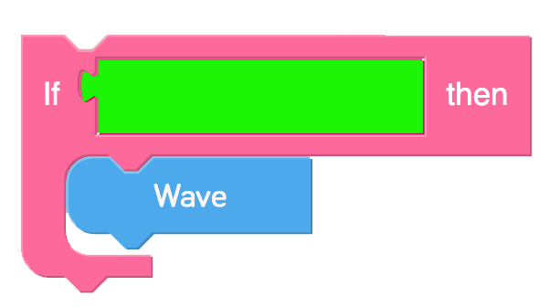
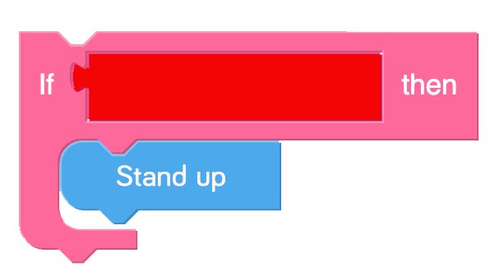
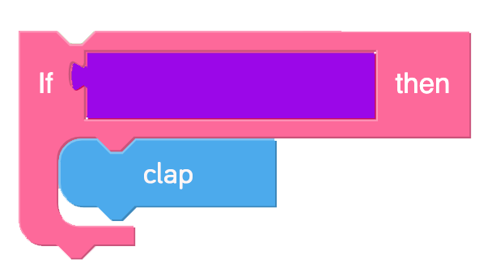
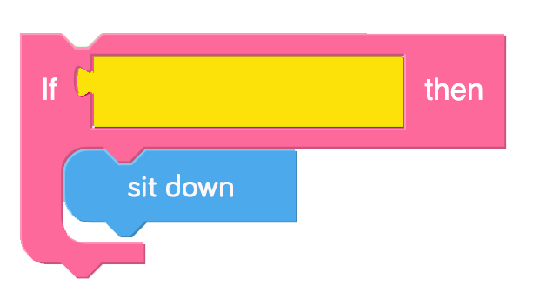
Notes:
Show your students these blocks on the screen, can your students read what the blocks are saying?
Play a game of “Selection Says”
You can either print the statements out, point to the statements randomly on the board or hold a coloured piece of card that matches the block colours.
Point or show a statement , ask your student to follow the instructions for each block when it is shown.

Slide 5
In computer science conditional statements (selection) can perform different computations or actions depending on whether a programmer-specified condition equals true or false.
Notes:
Explain to students about the importance of selection in computing/coding.
In computer science conditional statements /selection can perform different computations or actions depending on whether a programmer-specified condition equals true or false.
Selection is the programming structure through which a computer executes one or other set of instructions according to whether a particular condition is met. You can build selection into a sequence of instructions. This ability to do different things, depending on what happens as a program is running, makes programming a powerful tool. At the core of many educational games is a simple selection command: “If the answer is right then give a reward, otherwise (else) say the answer is wrong”. Selection statements can be “nested” inside one another, allowing more-complex sets of conditions to be used to determine what happens in a program.

Slide 6
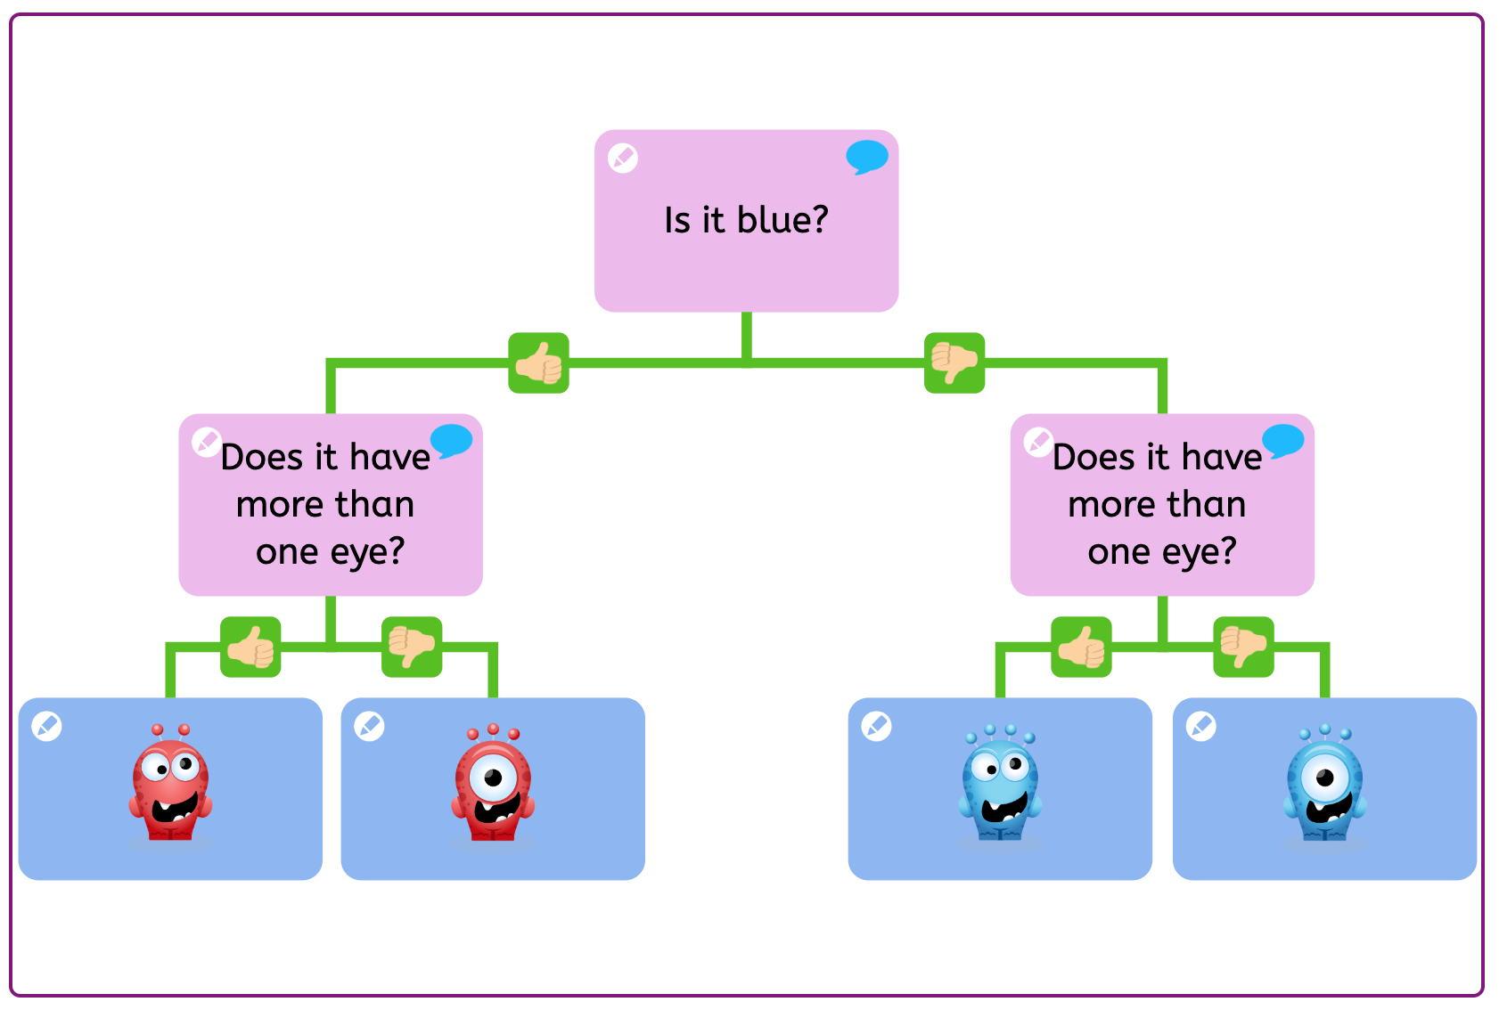
Notes:
Show children this simple branching database.
A branching database (sometimes called a binary tree) is a way of classifying a group of objects. If it has been designed properly, someone else could use the tree to identify one of the objects. It could be used, for example, to classify minibeasts, musical instruments, white powders or fruit.
Play this branching database with your students https://www.j2e.com/jit5?fileId=uBtM02xm57VCZOeO-1
jit branch is a fantastic tool which can be found in the j2e Toolsuite.

Slide 7
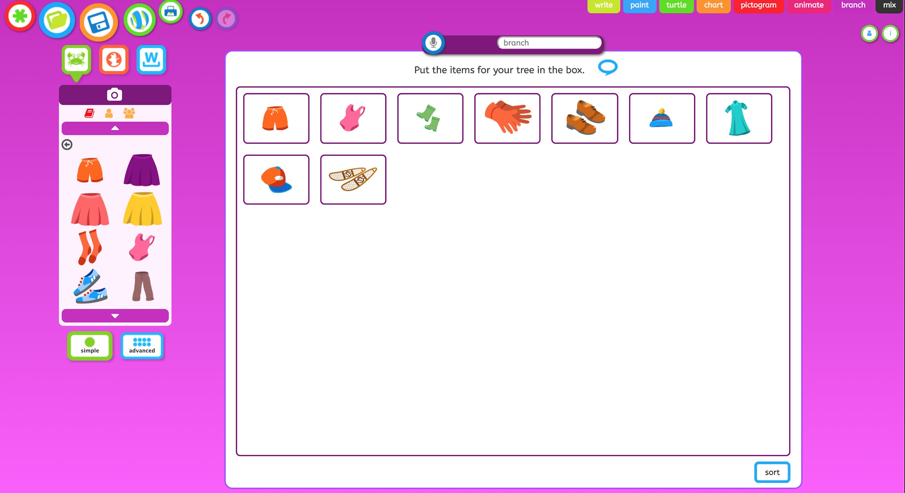
Notes:
Ask you students to make their own branching database using j2branch found inside of jit5.
Ask you student to think about clear, key questions/statements that can create true/false questions.
You may want to pick a simple theme like ‘clothes’ and create simple statements ”if running”.
Allow time during the end of the lesson to let students share and play each other’s branches.

